Slide 1
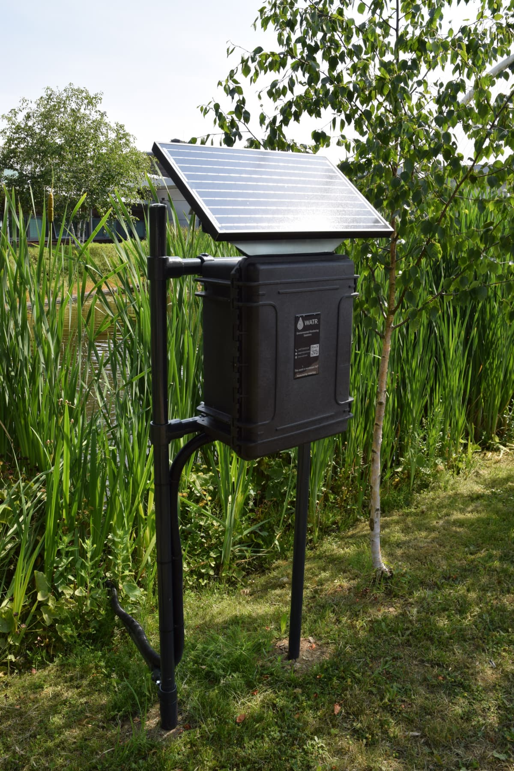
Sensors
Summary of data collection using remote sensors
v3
Tom Bryden
29 September 2025

Slide 2
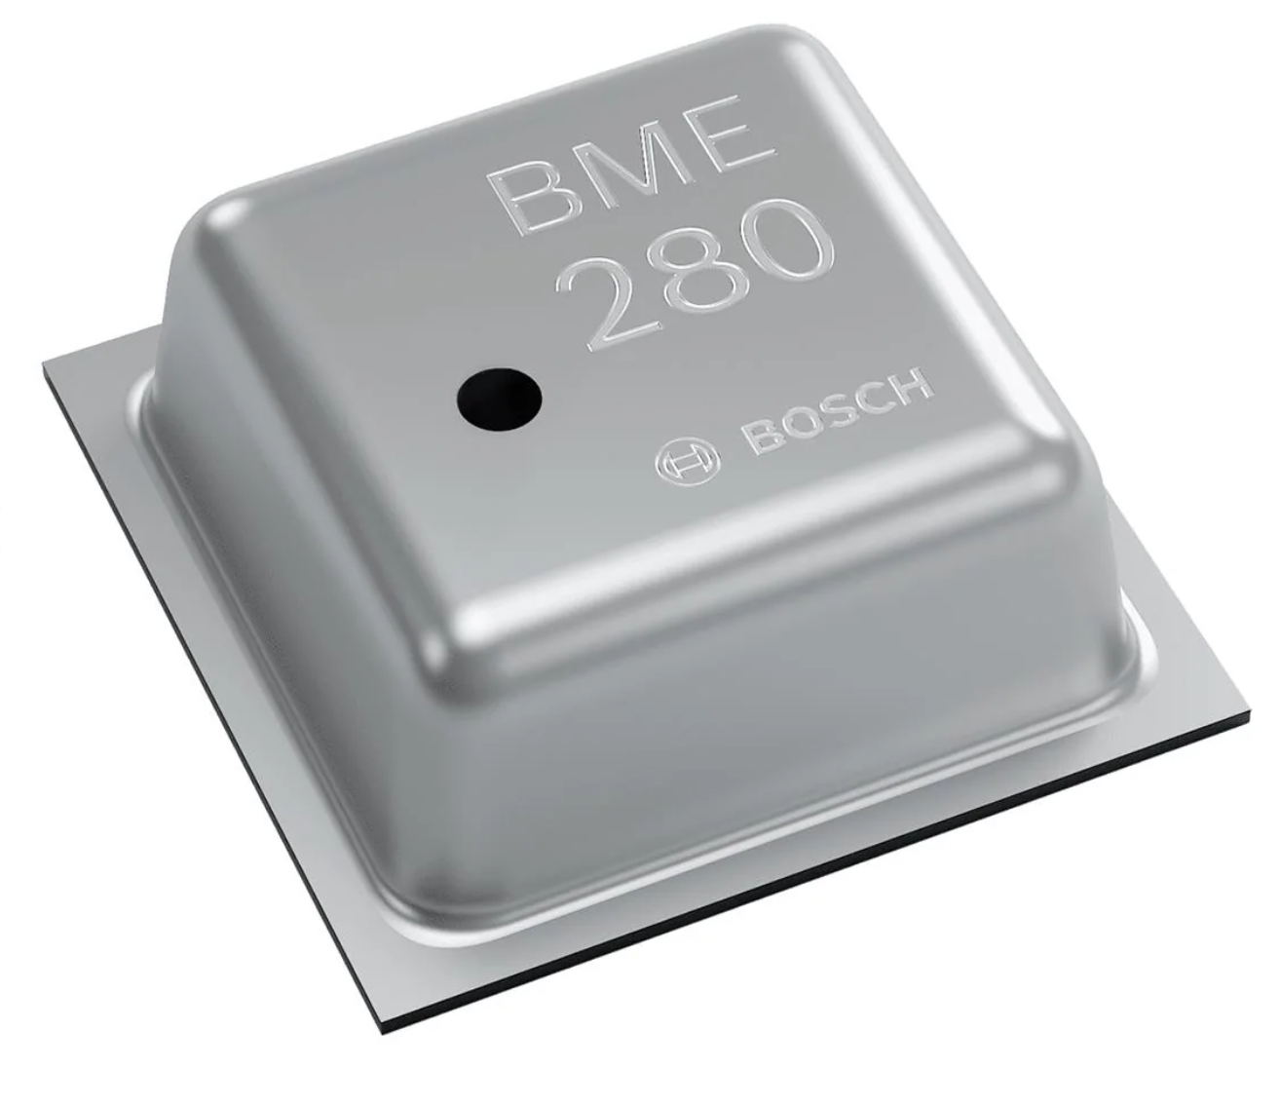
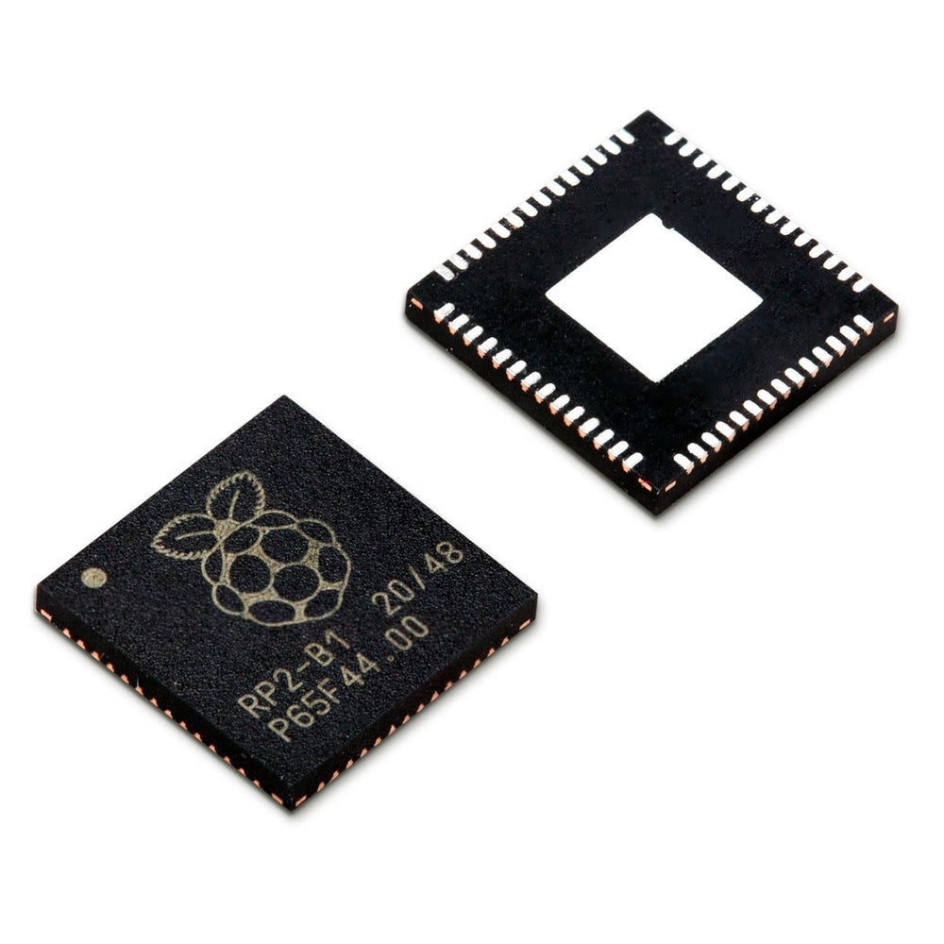
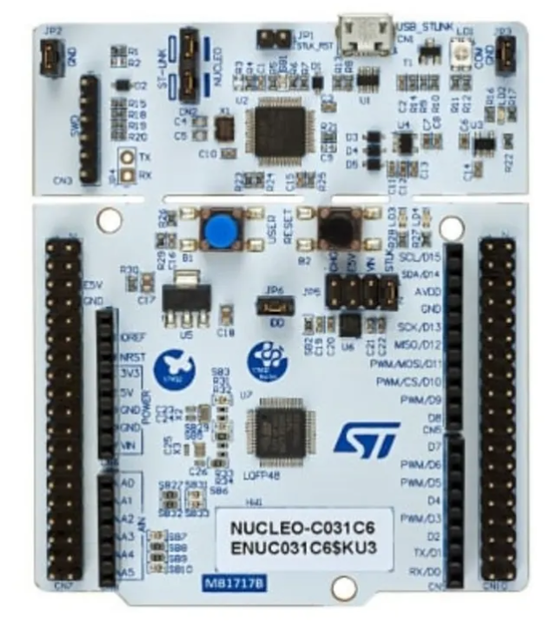
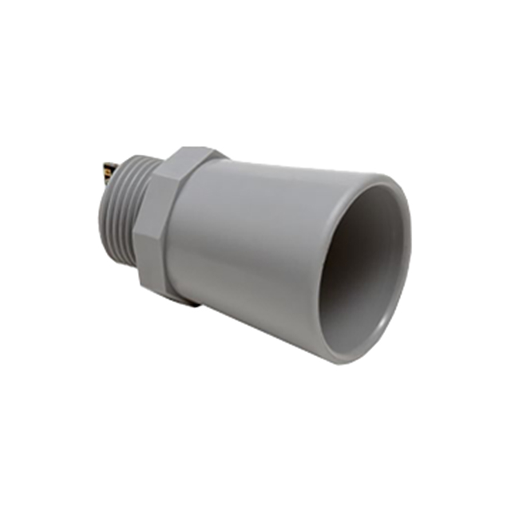
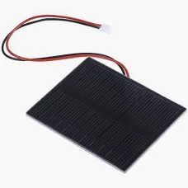
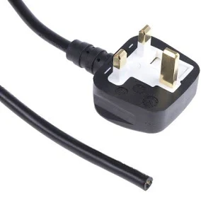
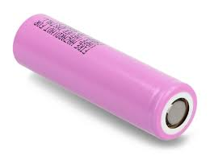
Overview
2
Connections and communication
2 power lines (positive & negative)
1-4 communication lines
1
3
4
Physical property to measure
Temperature
Gas concentration
Distance
etc.
Sensor
Microcontroller
Send data
To local storage
Via mobile network
To central location
etc.
5
Power supply

Slide 3
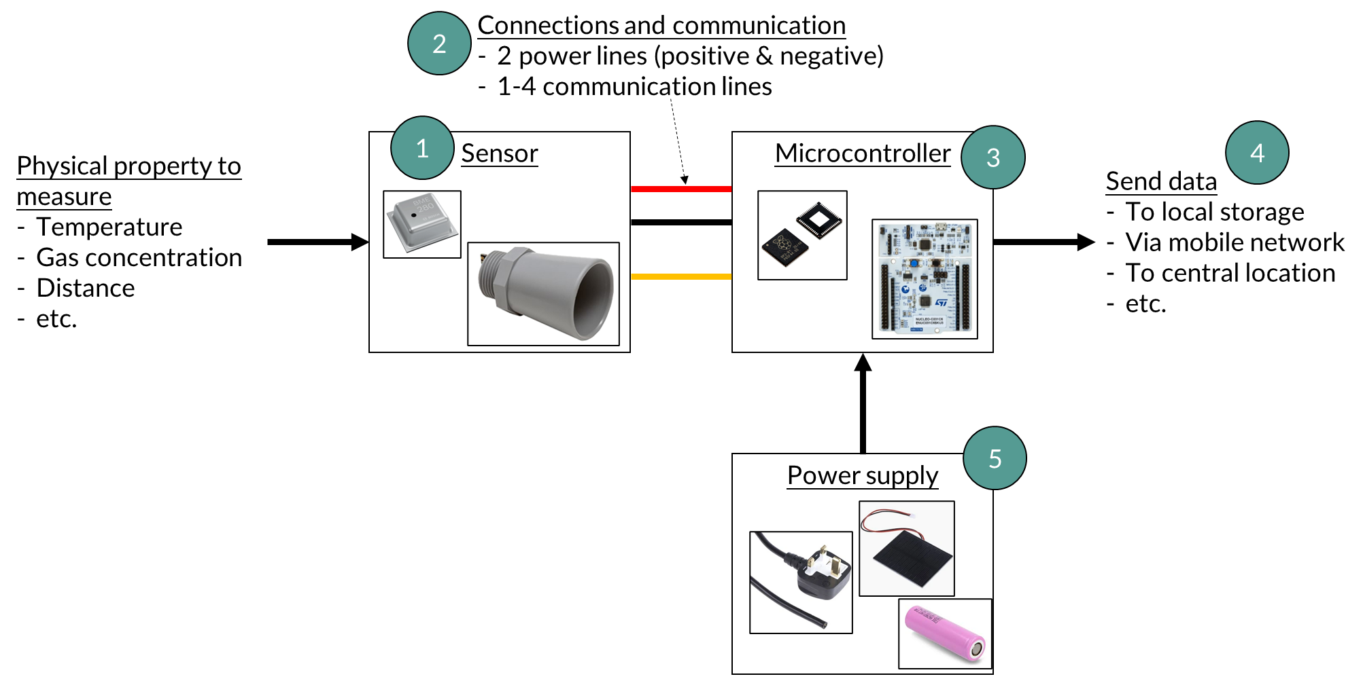
1. Sensor

Slide 4
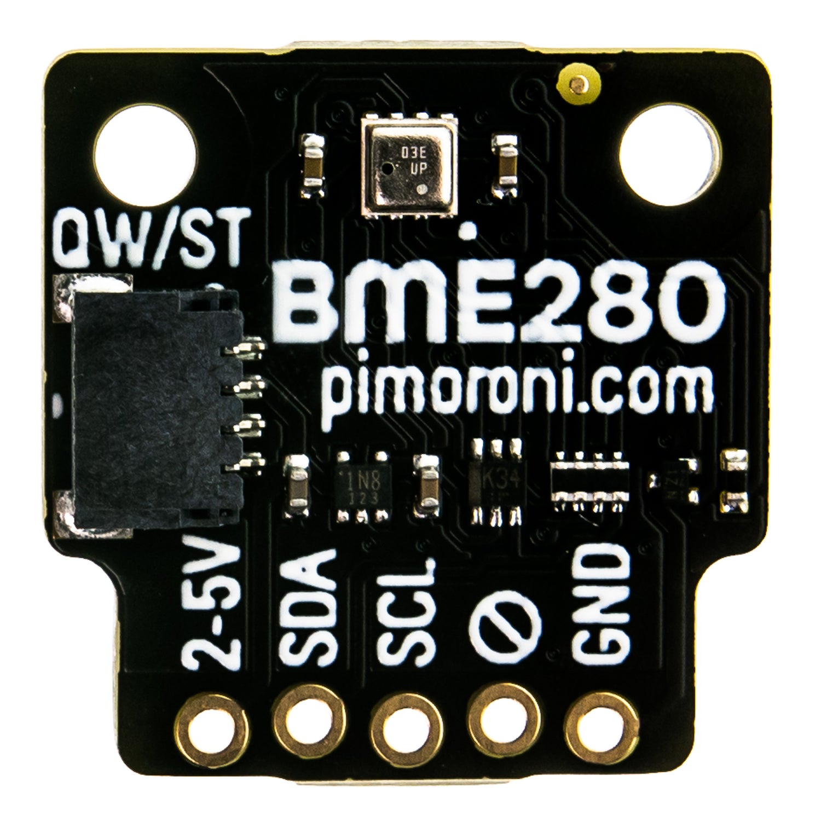
1.a Sensor
Sensor measures a physical quantity and converts it to a communication protocol (communication protocols are described in slide 2.b)
The method of converting physical property to communication protocol varies for every sensor and depends on the physical quantity being measured
- e.g. Resistance Temperature Detector: (platinum, nickel, etc.): resistance increases linearly with temperature
Each sensor needs to be supplied with power wires (1 positive and 1 negative) and communication wires (see slide 2.a)
Small circuits may be required next to the sensor:
Sensor purchased from Bosch
Small circuit next to sensor, in this case made by the company Pimoroni but could be done yourself
Output to microcontroller

Slide 5
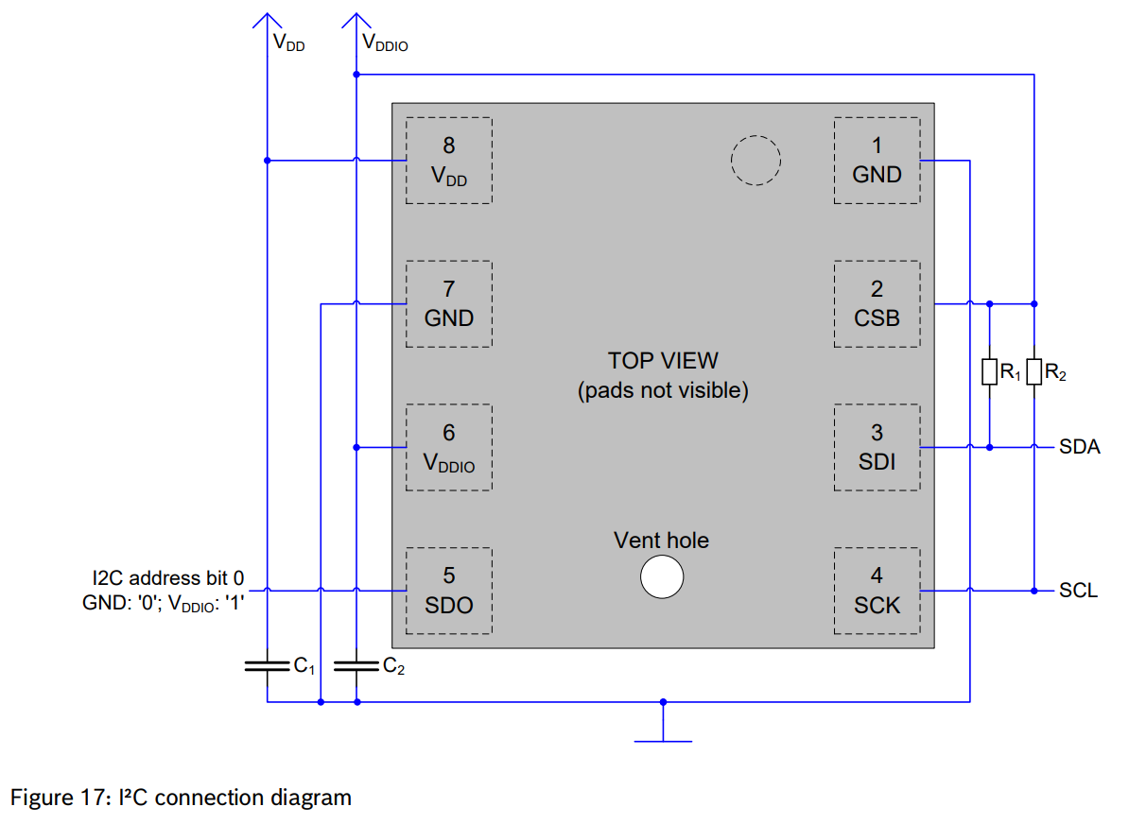
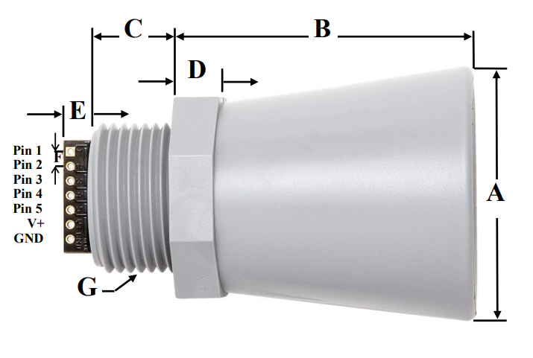
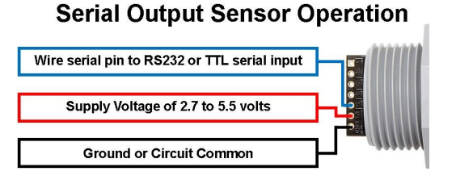
1.b Sensor examples
Bosch BME280
MaxBotix SCXL-MaxSonar-WR
Physical property to measure | Communication protocol to convert to
Humidity, pressure, temperature | I2C
Physical property to measure | Communication protocol to convert to
Ultrasonic distance | RS232
Power from microcontroller
Sensor measuring physical property
Sensor measuring physical property
Communication and power from microcontroller
Small local circuit
Communication to microcontroller

Slide 6
2. Connections and communication

Slide 7
2.a Connections and communication
Sensor needs to be connected to the microcontroller using power and communication wires
The microcontroller may be located right next to the sensor on the same circuit board, or could be further away and a wire connects the two
Power wires:
Two wires required, one for positive and one for negative
If the sensor is low power, it may be powered directly from the microcontroller. If more power (or higher voltage) than the microcontroller can deliver is required, a separate power supply circuit is needed
Communication, see next slide

Slide 8
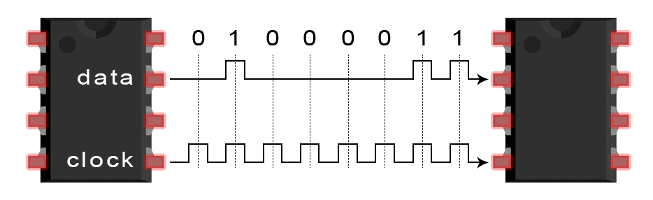
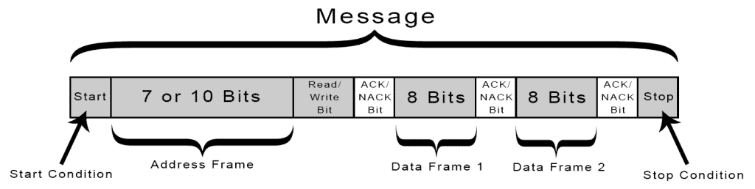
2.b Communication
Number of communication wires depends on the sensor communication protocol used (which is determined by the sensor manufacturer, see slide 1.b)
The physical quantity measured by the sensor is converted to bits by the sensor manufacturer and then the communication protocol determines how these bits are sent to the microcontroller
Common communication protocols include:
I2C https://circuitbasics.com/basics-of-the-i2c-communication-protocol/
SPI https://www.circuitbasics.com/basics-of-the-spi-communication-protocol
UART https://www.circuitbasics.com/basics-uart-communication/
Sensor
Microcontroller

Slide 9
3. Microcontroller

Slide 10
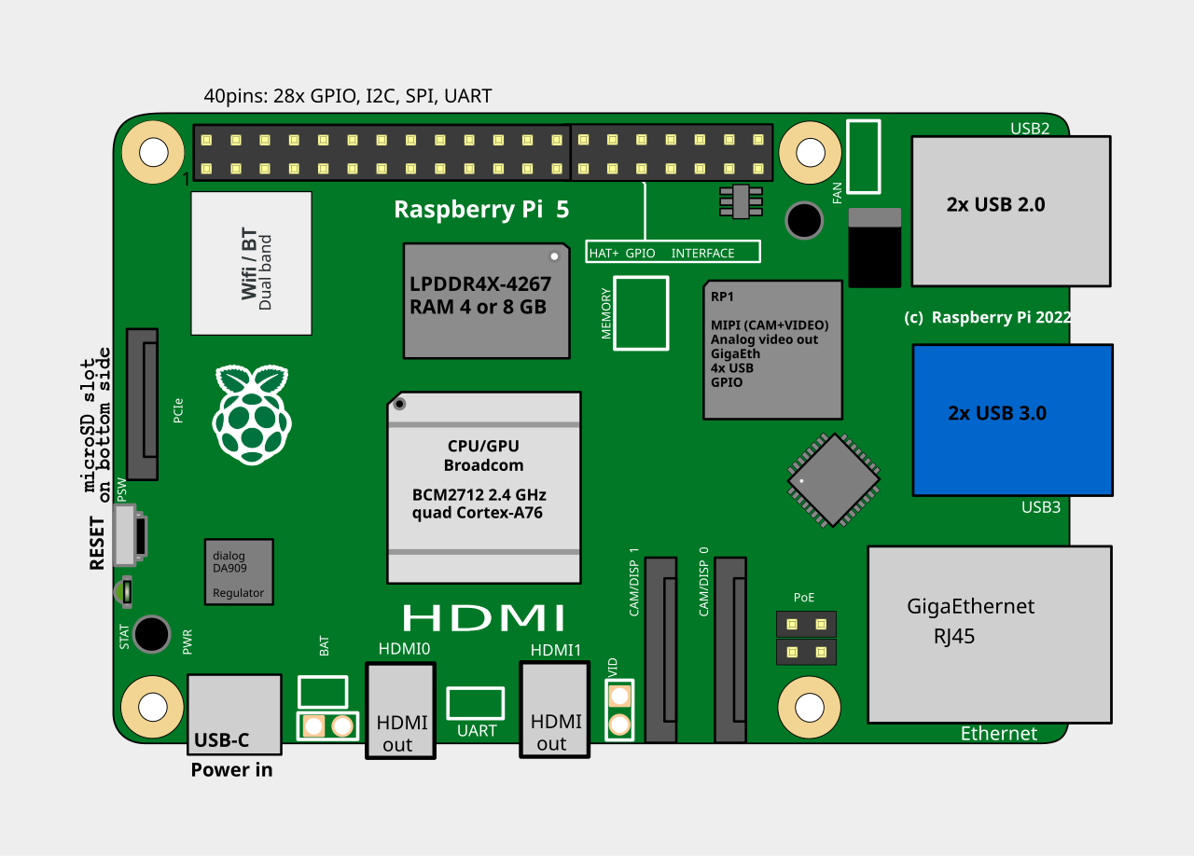
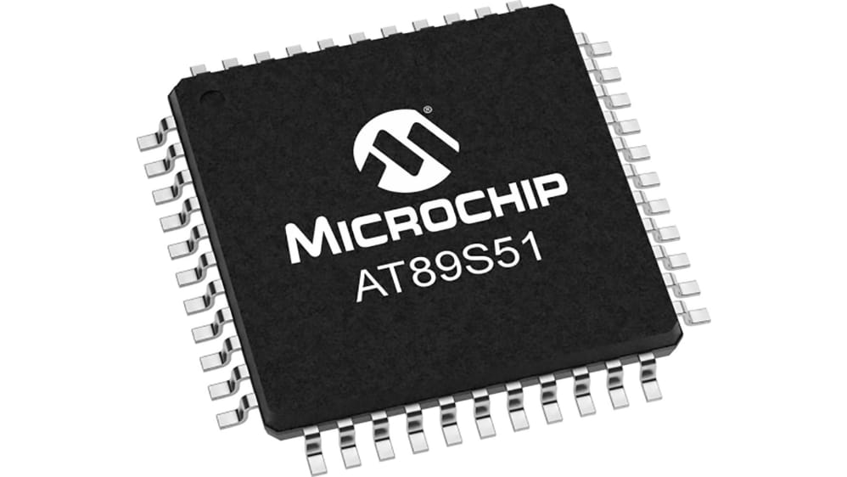
3.a Microcontroller
Contain all components on single chip
Cons: Less powerful than full computer
Pros: Smaller, cheaper, uses far less power
Well suited for remote sensing applications
Full Computer
Permanent memory
(SSD)
Temporary memory (RAM)
CPU
Microcontroller

Slide 11
3.a Microcontroller use
Microcontroller program is written on a regular computer and then uploaded to the microcontroller where it runs in a loop
Remote connections*:
Cannot remotely connect whenever you want, as listening for remote connections uses microcontroller power
When the microcontroller wakes up it can check if anyone wants to connect, or check for program updates
Typical microcontroller program structure
1. Connect to sensor and read data, see slide 2.b
2. Connect to internet
3. Send API POST request, containing sensor measurement, to website
4. Check website to see if any updates to program are available, if yes, download updates
5. Go to sleep for a set amount of time
*This is my experience, not sure on how this works in industry

Slide 12
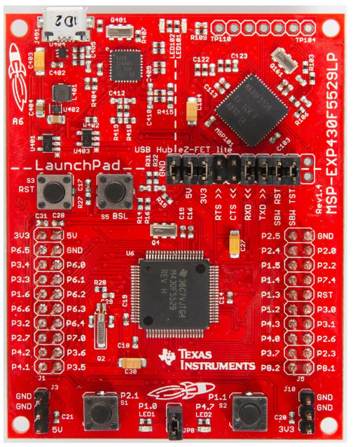
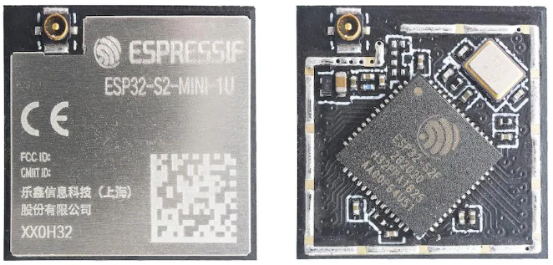
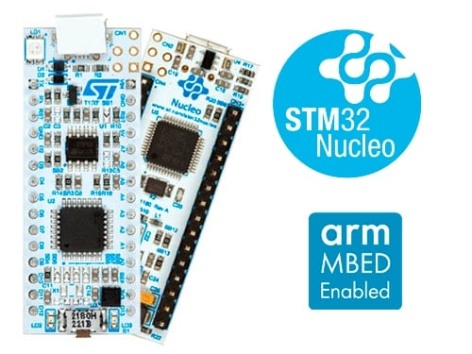

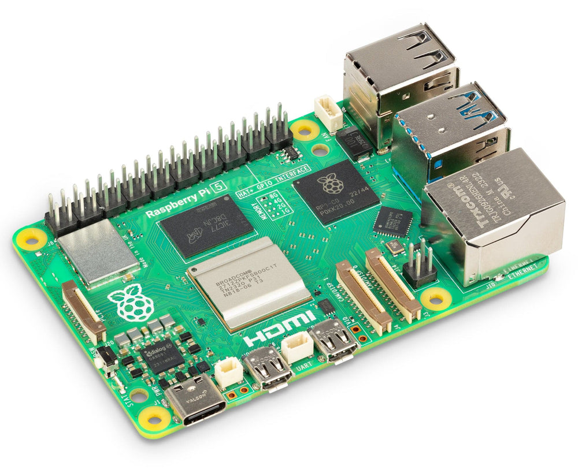
3.b Microcontroller examples
ESP32
Texas Instruments
STMicroelectronics
Whereas a Raspberry Pi is a full computer, not a microcontroller, requires more power
Arduino

Slide 13
4. Send data

Slide 14
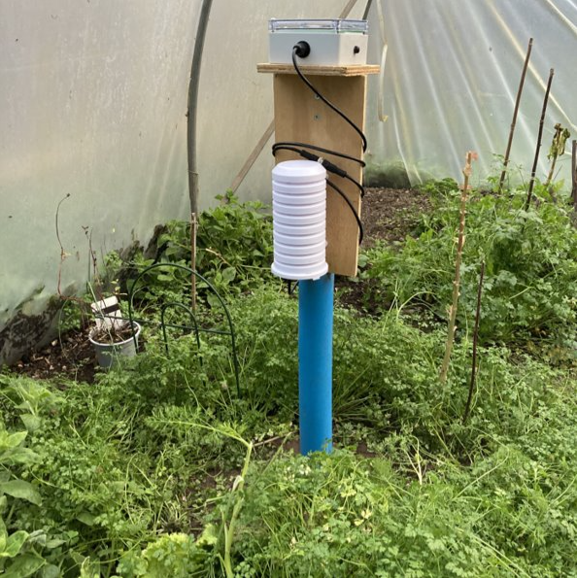
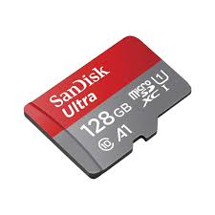
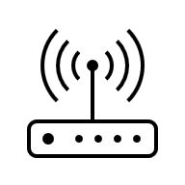


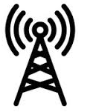
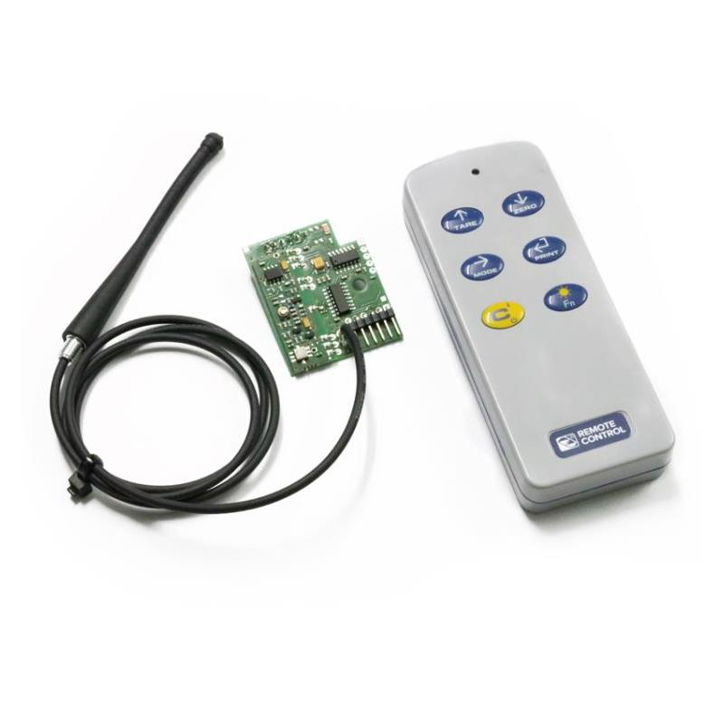

4.a Send data
Depends on location and available connections
1. Store locally on memory card | Need to physically collect data
2. Transmit via Wi-Fi | May not be a Wi-Fi connection available
3. Transmit via mobile network | Requires signal and mobile network usage costs
4. Transmit via radio frequency | Requires computer in another location to receive data
4G

Slide 15
4.b Send data POST request
How I send data from the sensor to the database, may be different in industry
Microcontroller
Standard POST request:
bespokesensors.com/databases/post-sensor.php?api_key=XXX&temperature=21.26&humidity=85
Hosted webpage
bespokesensors.com/databases/post-sensor.php
Extract api_key and sensor data from POST
Use api_key to work out which table to insert sensor data into
Generate SQL query to insert data into table
Execute SQL query, data stored in database
String httpRequestData = "api_key=" + apiKeyValue + "&temperature=" + String(temperat) + "&humidity=" + String(humidity) + "";
if ($_SERVER["REQUEST_METHOD"] == "POST") {
…
$sensor_sql_init = "INSERT INTO " . $table . " (";
…
…
if ($sensor_conn->query($sensor_sql) === TRUE) {

Slide 16

4.c Send data via radio frequency
Radio frequency has the lowest power requirements, can be transmitted relatively long distances (typically up to 10 km in rural locations) and does not cost for data usage
However, radio frequency requires another computer (a gateway) to receive the transmitted data, the gateway computer has a radio frequency receiver and is in a building with power and internet. The gateway computer uploads the received data to the database.
The Things Network https://www.thethingsnetwork.org/
Creating a network of gateway computers around the world (LoRaWAN®)
My understanding is then you just use a nearby LoRaWAN® gateway instead of requiring your own gateway computer
Unsure how much this is used in industry

Slide 17
5. Power supply

Slide 18
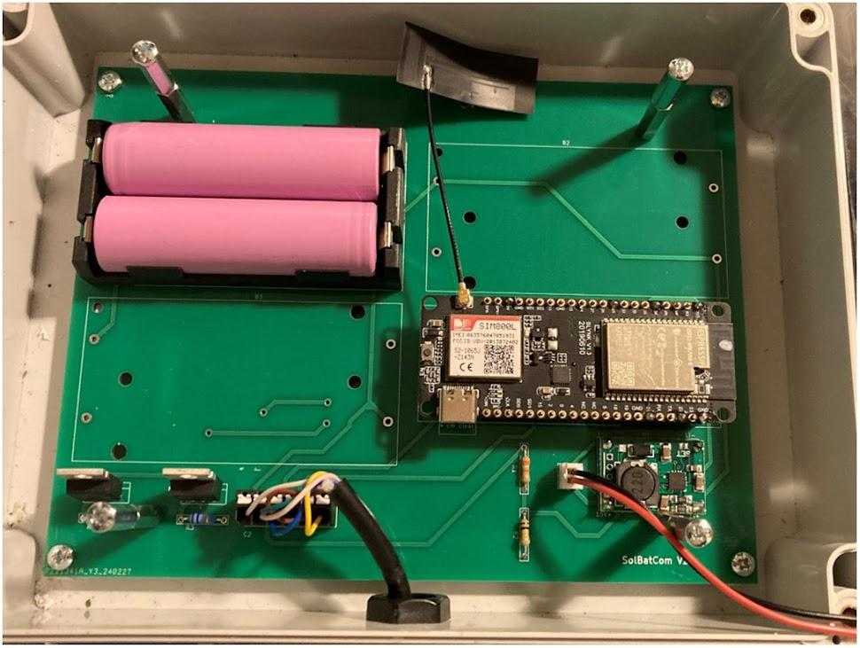
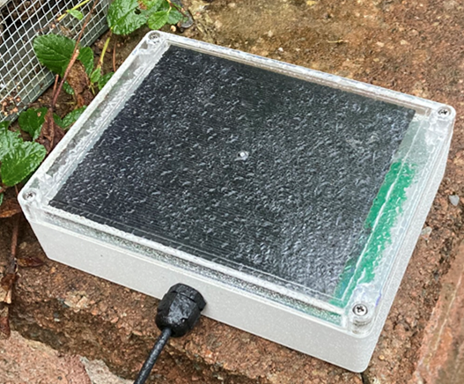
5.a Battery and solar
Almost always Lithium-ion battery and solar panel, could be mains connected if not remote
Quantity of data seems to normally be limited by power constraints
Biosphere water sensors changing data collection frequency summer / winter
3. Batteries, 2.5-4.2 V
2. Battery charger circuit, in: 5.5 V, out: 2.5–4.2 V
4. Microcontroller, with onboard voltage regulator
in: 2.5–4.2 V, regulated: 3.3 V
Solar, in: 5.5 V

Slide 19
Conclusion
2
Connections and communication
2 power lines (positive & negative)
1-4 communication lines
1
3
4
Physical property to measure
Temperature
Gas concentration
Distance
etc.
Sensor
Microcontroller
Send data
To local storage
Via mobile network
To central location
etc.
5
Power supply

